Slide 1
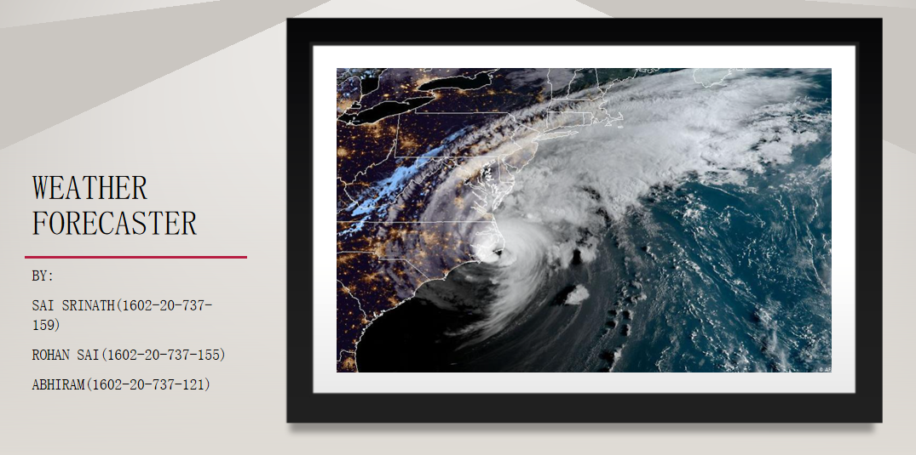

Slide 2
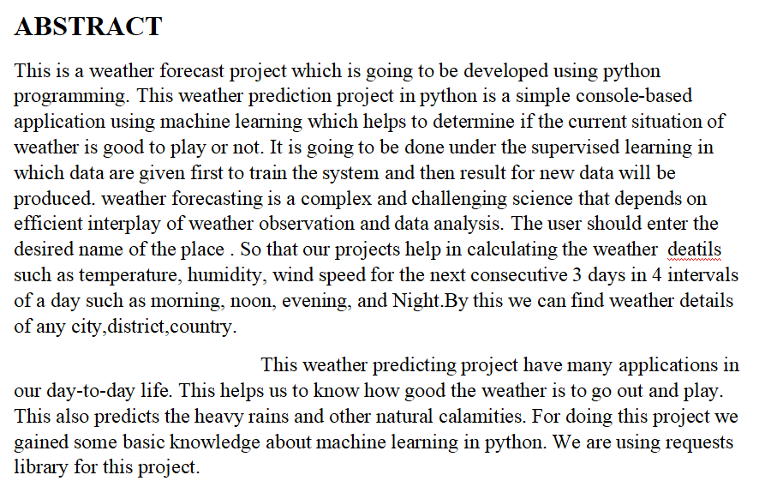

Slide 3
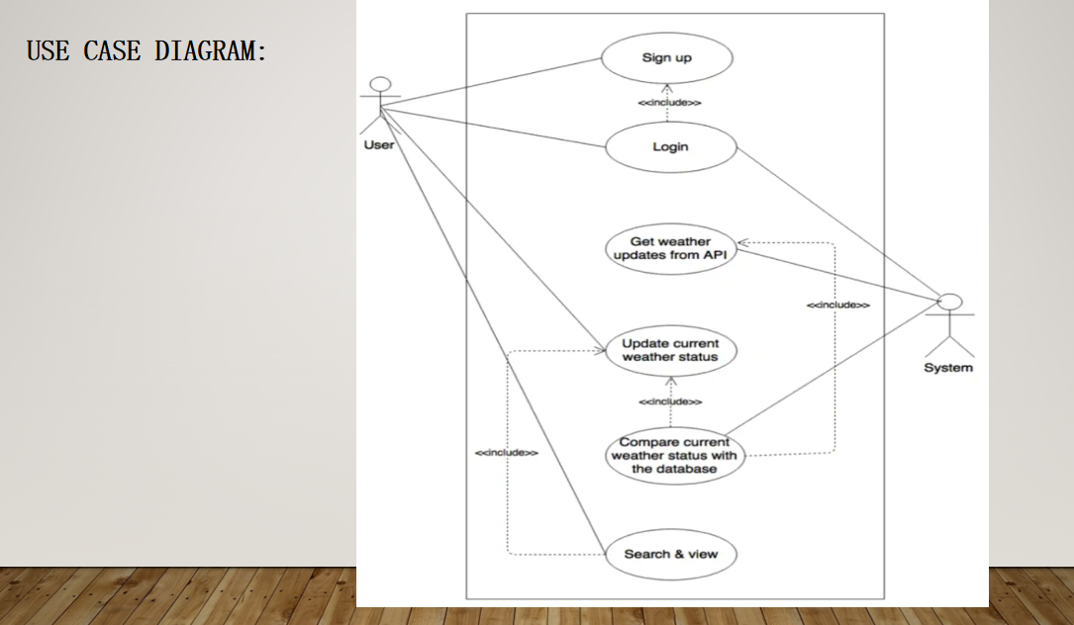

Slide 4
TECHNOLOGY USED:
1.LIBRARIES USED:
--tkinter:
import tkinter as tk
from tkinter import *
from tkinter import messagebox
--requests:
import requests
2.DATASET EXPLORATION:
--url = 'https://wttr.in/{}'.format(entry1.get())
res = requests.get(url)
3.TAKING PLACE INPUTS:
--button1 = tk.Button(text='Get WEATHER DETAILS', command=weather, bg='brown', fg='white',
font=('helvetica', 9, 'bold'))

Slide 5
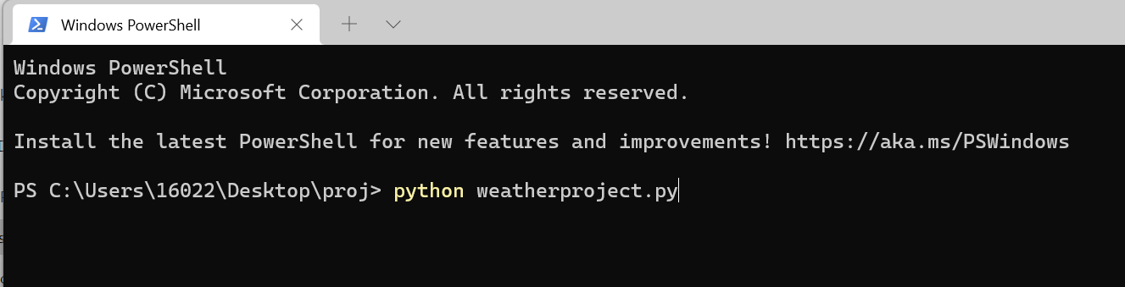
EXECUTION SCREENSHOTS:

Slide 6
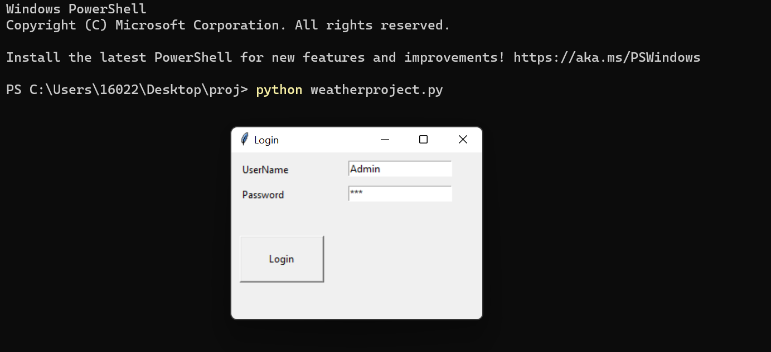
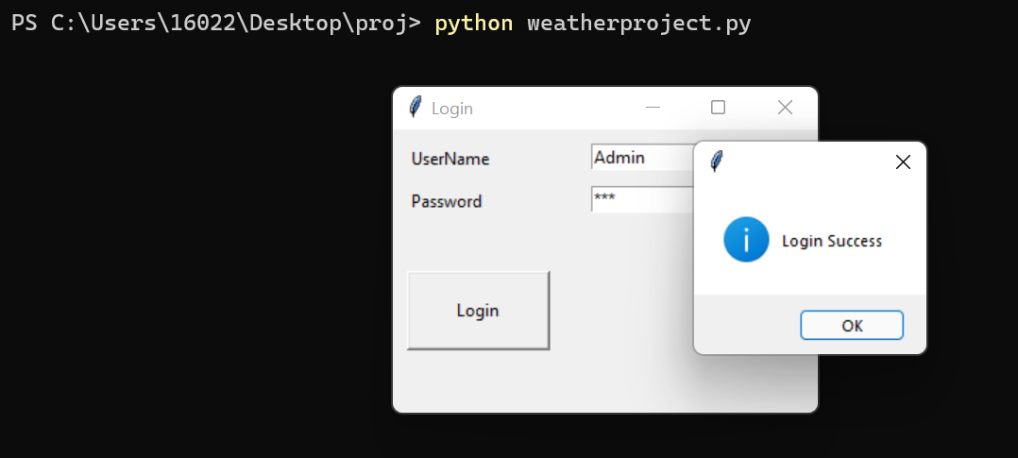

Slide 7
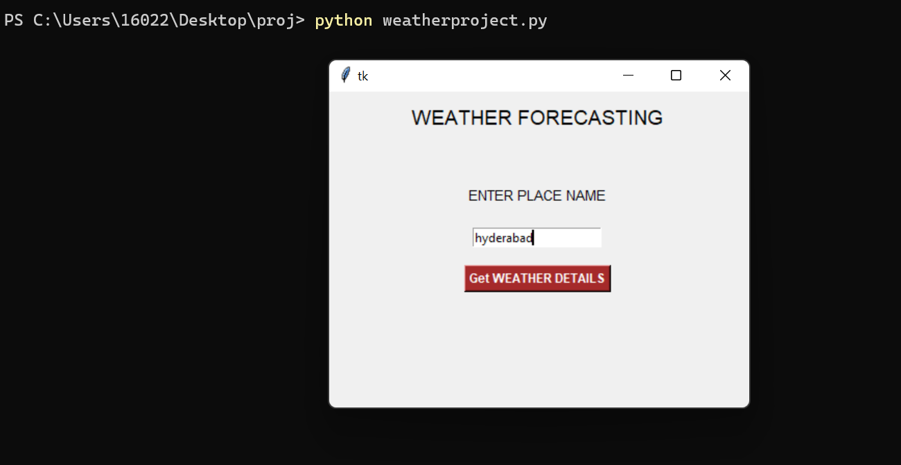

Slide 8
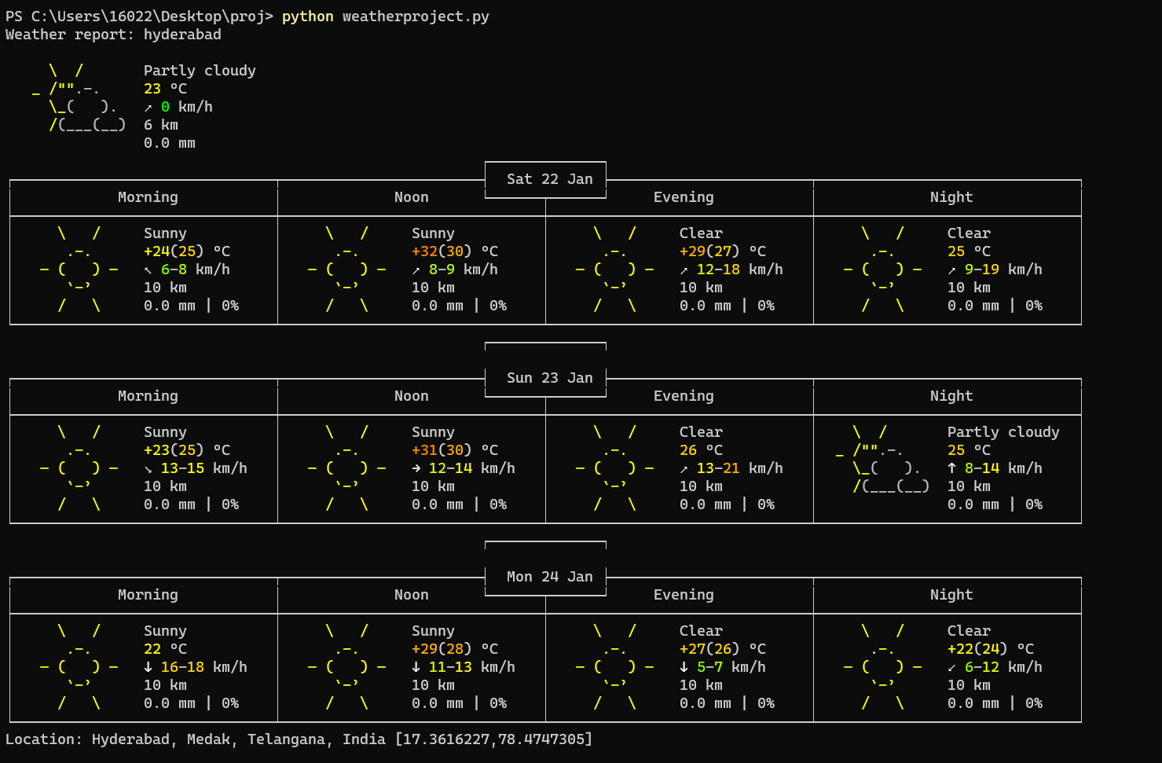

Slide 9
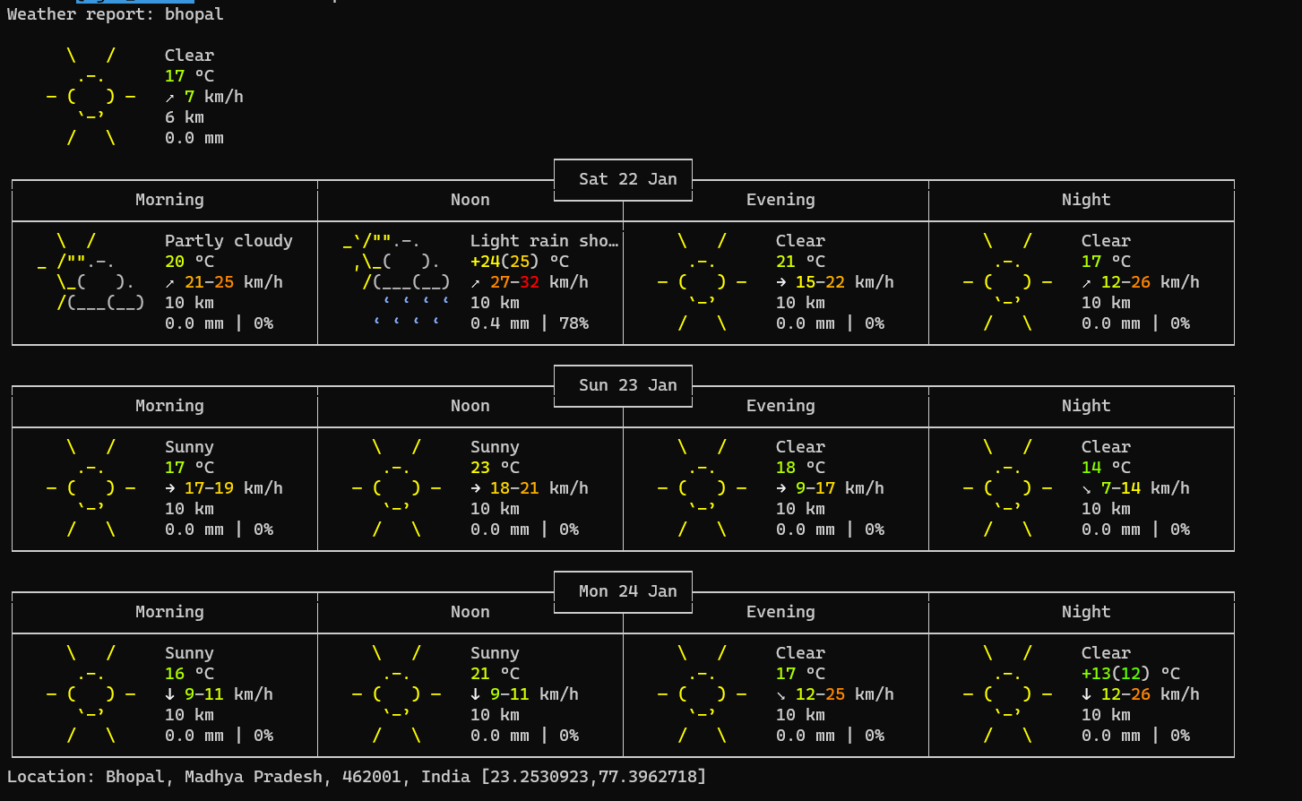
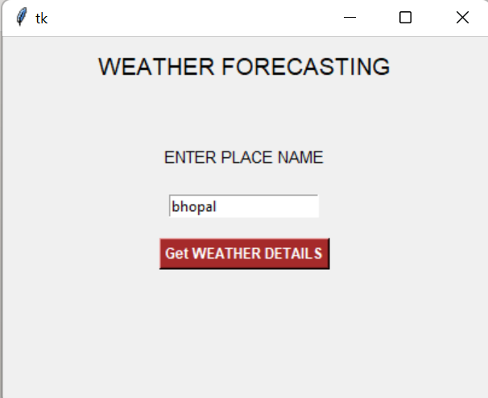

Slide 10
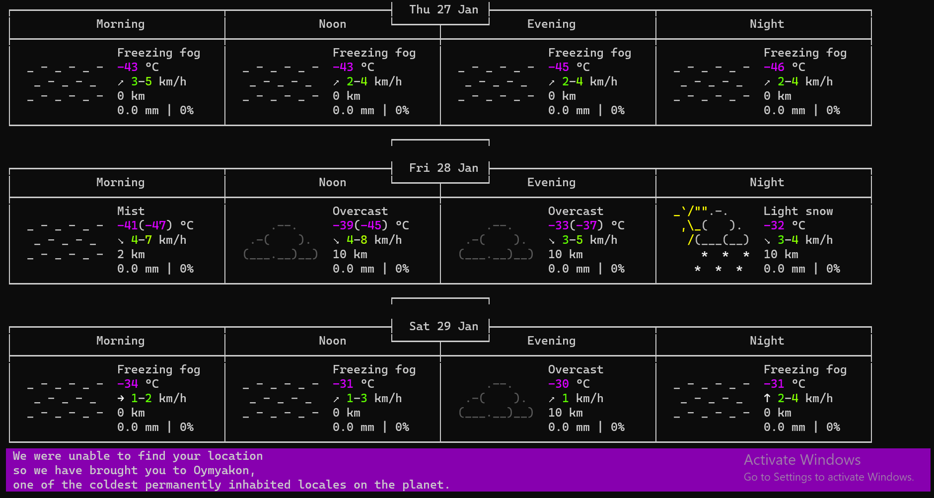
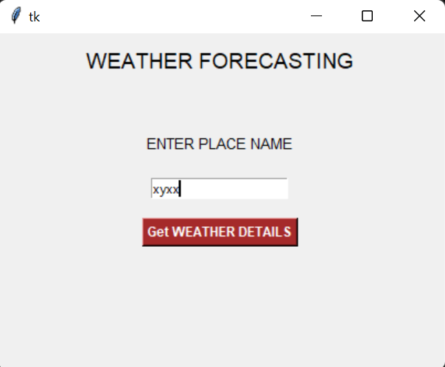

Slide 11
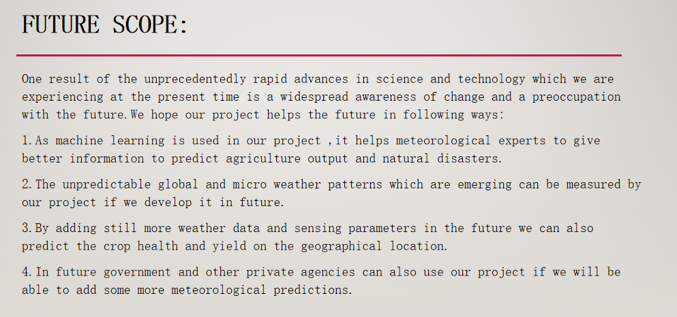
CONCLUSION

Slide 12


